Slide 1
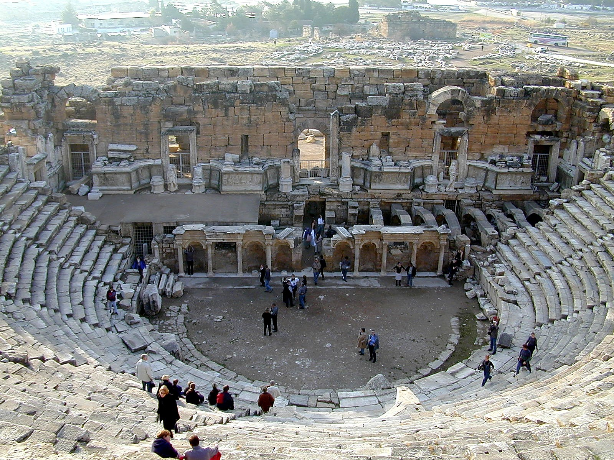
1 Peter 2.4-10
Christ as God’s Cornerstone
Theater in Hierapolis
This photo is from the collection "Pictorial Library of Bible Lands, volumes 1-10," © 2006 by Todd Bolen, BiblePlaces.com

Slide 2
2.4-5 NASB: And coming to Him as to a living stone which has been rejected by men, but is choice and precious in the sight of God, ⁵ you also, as living stones, are being built up as a spiritual house for a holy priesthood, to offer up spiritual sacrifices acceptable to God through Jesus Christ.

Slide 3
2.6: For this is contained in Scripture: “Behold, I lay in Zion a choice stone, a precious corner stone, and he who believes in him will not be disappointed.”

Slide 4
2.7-8: This precious value, then, is for you who believe; but for those who disbelieve, “The stone which the builders rejected, this became the very corner stone,” ⁸ and, “A stone of stumbling and a rock of offense”; for they stumble because they are disobedient to the word, and to this doom they were also appointed.

Slide 5
2.9-10: But you are a chosen race, a royal priesthood, a holy nation, a people for God's own possession, so that you may proclaim the excellencies of Him who has called you out of darkness into His marvelous light; ¹⁰ for you once were not a people, but now you are the people of God; you had not received mercy, but now you have received mercy.

Slide 6
† We must have Christ as our savior to be part of God’s plan now and in eternity.
† We must be involved in the church.
† As a church, we offer God spiritual sacrifices through Christ, by being devoted to God [including praising God!], depending on God, and submitting to /obeying God [including sharing our blessings with others].
† Even if the world is hard on us, we can know we are loved by God, we can be a part of the church community [which is multi-racial, and includes all types of people], and we can trust God will deliver us to Heaven because of Christ.

Slide 7
1 Peter 2.4-10
Christ as God’s Cornerstone
Theater in Hierapolis
This photo is from the collection "Pictorial Library of Bible Lands, volumes 1-10," © 2006 by Todd Bolen, BiblePlaces.com

